Slide 1
PPEM using Homomorphic encryption
Prof. Adi Akavia's Secure Cloud Computing Laboratory, Fall 2022-2023
Supervised by Prof. Adi Akavia
Abed-Elrahman Abu Hussein, Michael Rodel

Slide 2
Abstract - ML
We introduce a Privacy Preserving Expectation Maximization (PPEM) protocol that addresses privacy concerns in distributed algorithms.
The protocol combines the Expectation-Maximization (EM) algorithm and the Gaussian Mixture Model (GMM) to find maximum likelihood estimates in statistical models with hidden variables.

Slide 3
Abstract - Privacy
The proposed protocol ensures privacy and integrity of data across distributed parties, such as hospitals collecting disease data.
It employs homomorphic encryption, particularly the CKKS encryption, which allows computation on encrypted data.

Slide 4
Abstract - Privacy
The algorithm divides optimization formulas into sections and uses CKKS encryption to exchange information with a central server. The server combines encrypted intermediate updates, maintaining privacy, and enabling collaborative EM computation

Slide 5
Introduction to Expectation Maximization (EM) Algorithm

Slide 6
what DOES IT DO ?
The main idea of this algorithm is to divide the data set that we have into different clusters ,such that each cluster is different than the other clusters(distributions) .
This algorithm can be used for different applications in the industry, such as:
-Unsupervised clustering.
-As an optimization procedure .

Slide 7
USECASES :
Unsupervised clustering example :
This algorithm can be used to identify different species for example in the evolution genetic algorithms, as some of us as students used k-means clustering to determine the number of species and what makes them different from the others so that in the evolution phase of the algorithm we mix different species to get a new modified specie that has the best qualities of both it’s parents (from 2 different clusters).

Slide 8
Types of clustering models
Hard clustering : the clusters in this model do not overlap ,i.e the elements either belong to the cluster or don’t
Soft clustering : the clusters in this model can overlap as we use association of element x to cluster i based on the probability that it belongs to that cluster

Slide 9

K-means algorithm
K-means algorithm is an example of hard clustering as it aims to partition n observations into k clusters in which each observation belongs to the cluster with the nearest mean to the centroid of each cluster .

Slide 10
Mixture model
A mixture model uses probabilistic way of doing soft clustering
Each cluster uses a generative model gaussian or multinomial
With parameters that are partially unknown

Slide 11
Mixture models
Mixture models that are relevant to the PPEM that we will show and a rivaling PPEM :
Normal Mixture Model NMM:
As an example we can use Normal distribution in this Mixture Model.7
t-Mixture Model tMM:
Which adopts the (multivariate) t-density as its component density compared to NMM.

Slide 12
Expectation maximization algorithm
EM algorithm uses the mixture model as it uses a probabilistically grounded way of doing soft clustering
Each cluster corresponds to a gaussian (normal) distribution.
What we want to discover using the EM algorithm is the parameters which are the mean or covariance that are unknown

Slide 13
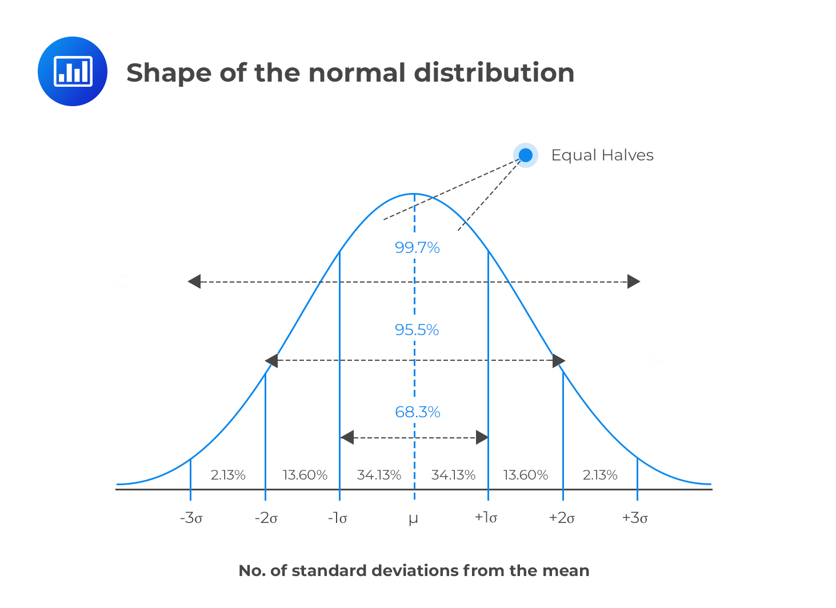
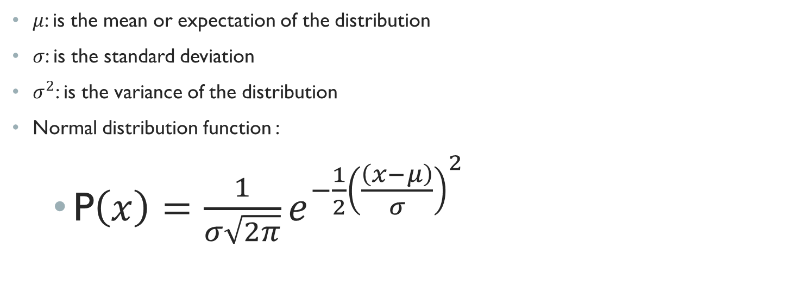
Gaussian distribution / normal distribution
$μ$: is the mean or expectation of the distribution
$σ$: is the standard deviation
$σ^{2}$: is the variance of the distribution
Normal distribution function :
P$\left(x\right)=\frac{1}{σ\sqrt{2π}}e^{{−\frac{1}{2}\left(\frac{\left(x−μ\right)}{σ}\right)}^{2}}$

Slide 14
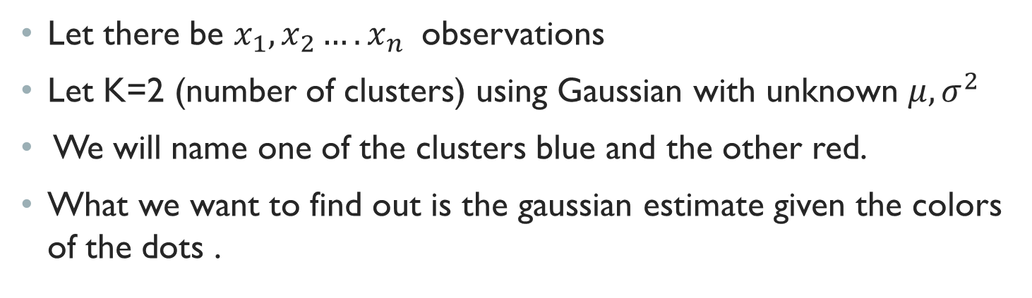
We will first use an example of a 1-dimensional mixture model
Let there be $x_{1},x_{2}….x_{n}$ observations
Let K=2 (number of clusters) using Gaussian with unknown $μ,σ^{2}$
We will name one of the clusters blue and the other red.
What we want to find out is the gaussian estimate given the colors of the dots .

Slide 15
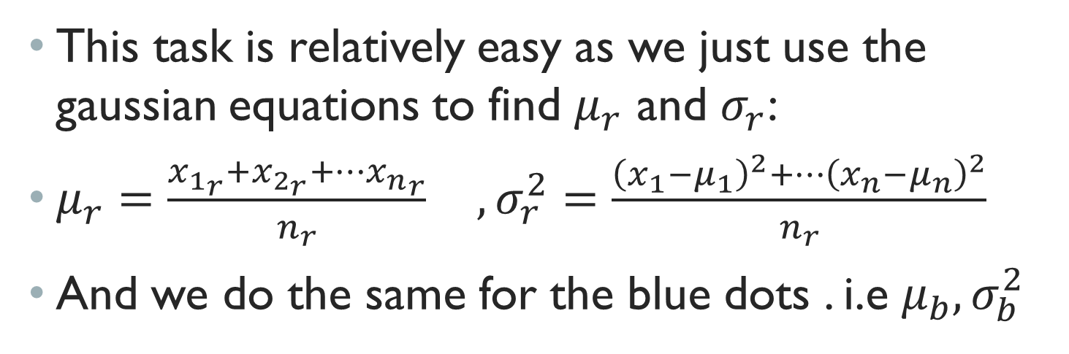
Find the gaussian
This task is relatively easy as we just use the gaussian equations to find $μ_{r}$ and $σ_{r}$:
$μ_{r}=\frac{x_{1_{r}}+x_{2_{r}}+…{x_{n}}_{r}}{n_{r}} ,σ_{r}^{2}=\frac{{{\left(x_{1}−μ_{1}\right)}^{2}+…\left(x_{n}−μ_{n}\right)}^{2}}{n_{r}}$
And we do the same for the blue dots . i.e $μ_{b},σ_{b}^{2}$

Slide 16
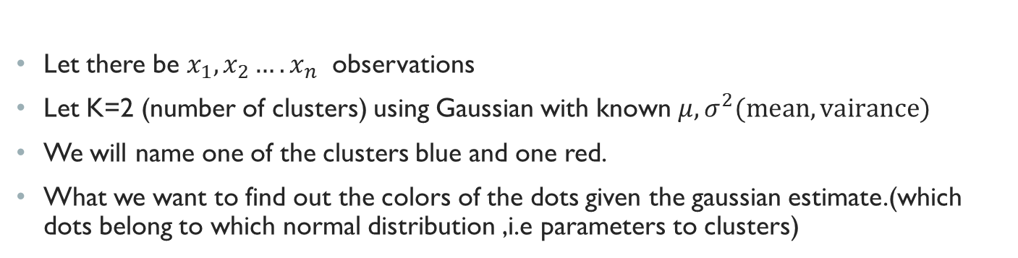
We will first use an example of a 1-dimensional mixture model
Let there be $x_{1},x_{2}….x_{n}$ observations
Let K=2 (number of clusters) using Gaussian with known $μ,σ^{2}(mean,vairance)$
We will name one of the clusters blue and one red.
What we want to find out the colors of the dots given the gaussian estimate.(which dots belong to which normal distribution ,i.e parameters to clusters)

Slide 17
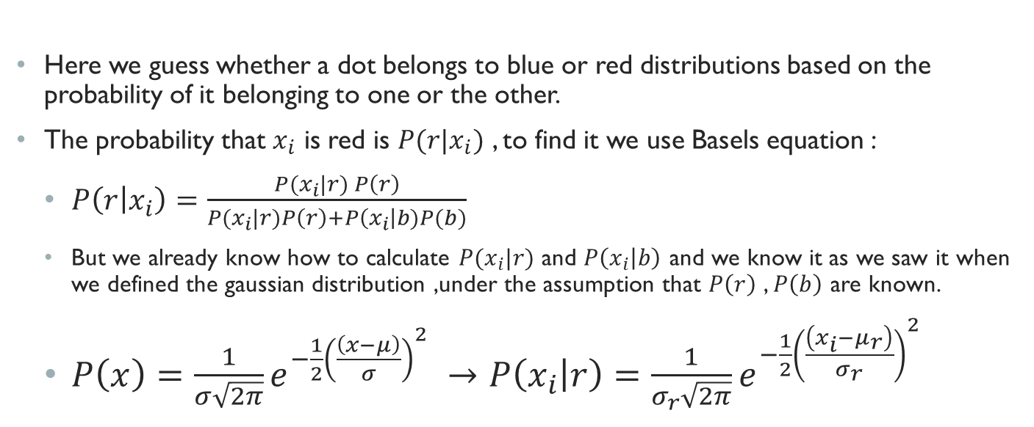
How do we assign each dot to which normal distribution
Here we guess whether a dot belongs to blue or red distributions based on the probability of it belonging to one or the other.
The probability that $x_{i}$ is red is $P(r|x_{i})$ , to find it we use Basels equation :
$P\left(r | x_{i}\right)=\frac{P(x_{i}|r) P\left(r\right)}{P(x_{i}|r)P\left(r\right)+P\left(x_{i}\right|b)P(b)}$
But we already know how to calculate $P(x_{i}|r)$ and $P\left(x_{i} | b\right)$ and we know it as we saw it when we defined the gaussian distribution ,under the assumption that $P\left(r\right)$ , $P\left(b\right)$ are known.
$P\left(x\right)=\frac{1}{σ\sqrt{2π}}e^{{−\frac{1}{2}\left(\frac{\left(x−μ\right)}{σ}\right)}^{2}} →P\left(x_{i} | r\right)=\frac{1}{σ_{r}\sqrt{2π}}e^{{−\frac{1}{2}\left(\frac{\left(x_{i}−μ_{r}\right)}{σ_{r}}\right)}^{2}}$

Slide 18
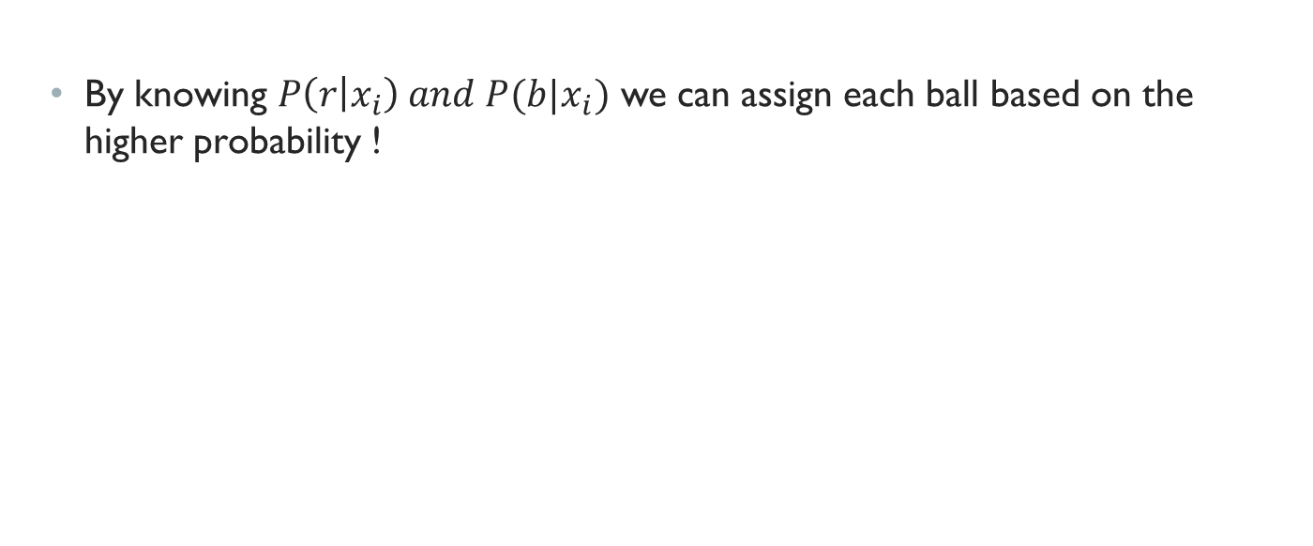
How do we assign each dot to which normal distribution
By knowing $P\left(r | x_{i}\right) and P(b|x_{i})$ we can assign each ball based on the higher probability !

Slide 19
Expectation maximizations motivation
With the first example we knew the colors of the dots and estimated the gaussian distribution .
With the second example we knew the gaussian distributions but we didn’t know which dot belonged to which gaussian.

Slide 20
Expectation maximizations motivation
The point here is that we need to know either the source of the observations to guess the gaussian parameters or know the gaussian parameters to guess the source of the observations.
The expectation maximization algorithm comes to solve this problem , given a number of distributions k with the source of the observations and the distributions unknown ,cluster the points into k clusters estimating the distribution and the sources of the observations.

Slide 21
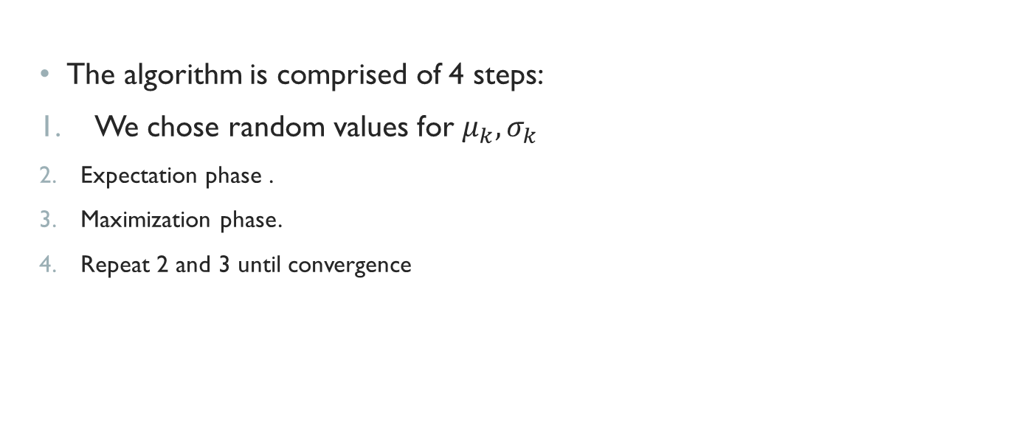
Expectation maximizations
The algorithm is comprised of 4 steps:
We chose random values for $μ_{k},σ_{k}$
Expectation phase .
Maximization phase.
Repeat 2 and 3 until convergence

Slide 22
Expectation phase
In this phase we assign each data point (dot) to a cluster probabilistically , meaning that we compute the probability that it came from a red distribution (cluster) as we have done in example 2.

Slide 23
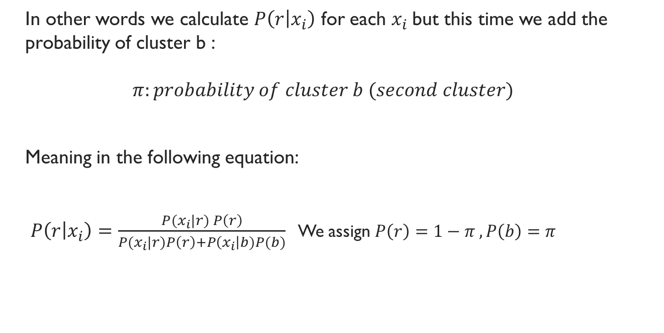
Expectation phase
In other words we calculate $P\left(r | x_{i}\right)$ for each $x_{i}$but this time we add the probability of cluster b :
$$π:probability of cluster b (second cluster)$$
Meaning in the following equation:
$P\left(r | x_{i}\right)=\frac{P(x_{i}|r) P\left(r\right)}{P(x_{i}|r)P\left(r\right)+P\left(x_{i}\right|b)P(b)}$ We assign $P\left(r\right)=1−π ,P\left(b\right)=π$

Slide 24
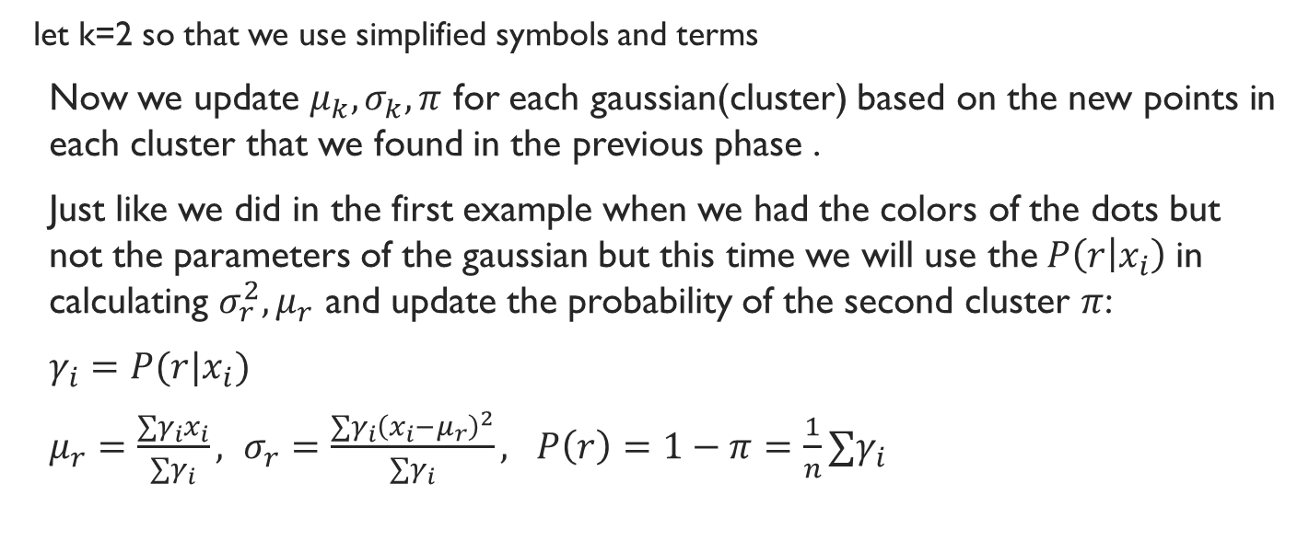
Maximization phase
let k=2 so that we use simplified symbols and terms
Now we update $μ_{k},σ_{k},π$ for each gaussian(cluster) based on the new points in each cluster that we found in the previous phase .
Just like we did in the first example when we had the colors of the dots but not the parameters of the gaussian but this time we will use the$P\left(r | x_{i}\right)$in calculating $σ_{r}^{2},μ_{r}$ and update the probability of the second cluster $π$:
$γ_{i}=P(r|x_{i})$
$μ_{r}=\frac{∑γ_{i}x_{i}}{∑γ_{i}}, σ_{r}=\frac{∑γ_{i}{\left(x_{i}−μ_{r}\right)}^{2}}{∑γ_{i}}, P\left(r\right)=1−π=\frac{1}{n}∑γ_{i}$

Slide 25
Example of the algorithm in 1-d
Firstly we will assign 2 random gaussian distributions (meaning their parameters)

Slide 26
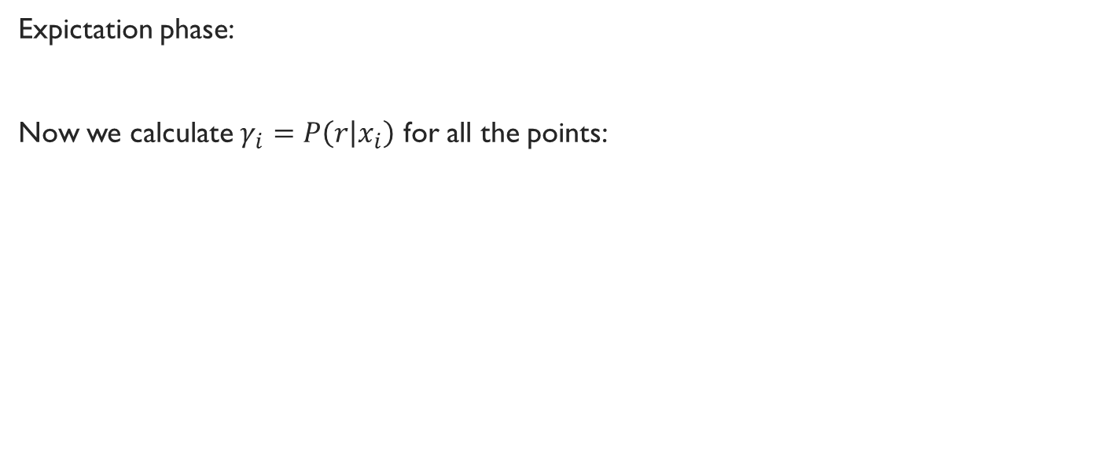
Example of the algorithm in 1-d
Expictation phase:
Now we calculate $γ_{i}=P\left(r | x_{i}\right)$ for all the points:

Slide 27
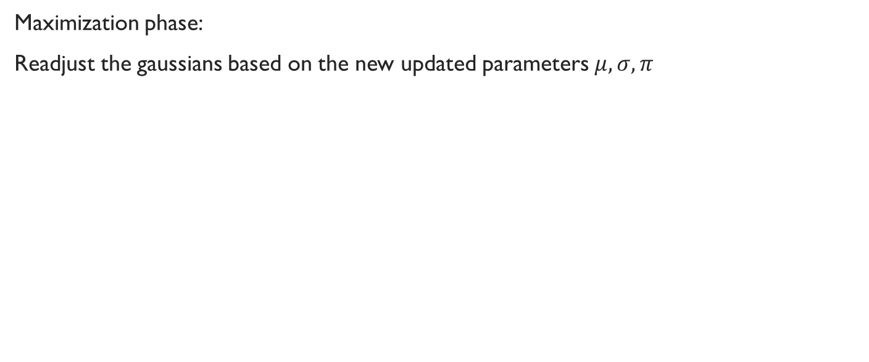
Example of the algorithm in 1-d
Maximization phase:
Readjust the gaussians based on the new updated parameters $μ,σ,π$

Slide 28
Example of the algorithm in 1-d
After convergence we will get :

Slide 29
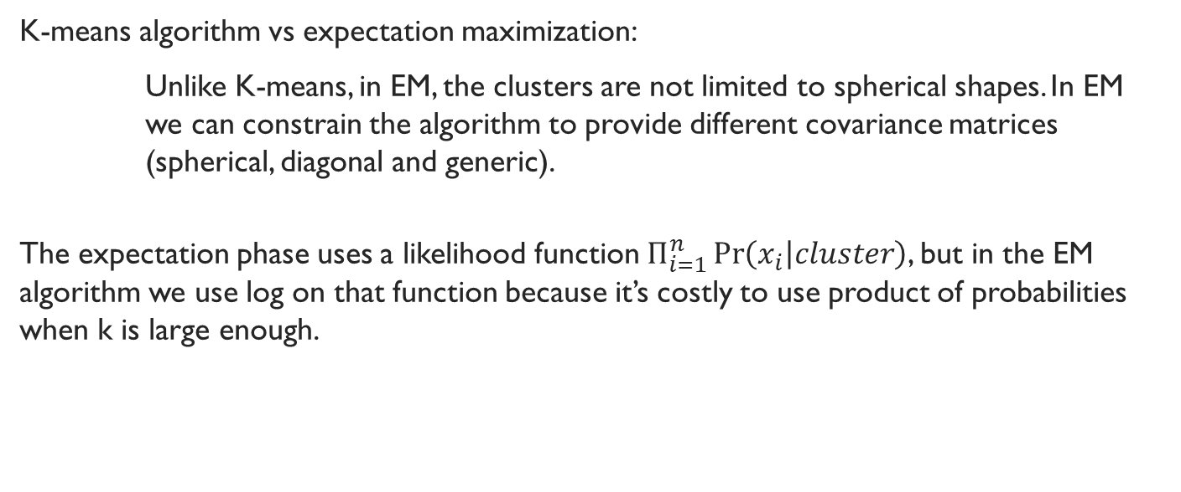
Notes
K-means algorithm vs expectation maximization:
Unlike K-means, in EM, the clusters are not limited to spherical shapes. In EM we can constrain the algorithm to provide different covariance matrices (spherical, diagonal and generic).
The expectation phase uses a likelihood function $Π_{i=1}^{n}\operatorname{Pr}\left(x_{i} | cluster\right)$, but in the EM algorithm we use log on that function because it’s costly to use product of probabilities when k is large enough.

Slide 30
Notes
K-means algorithm vs expectation maximization:
Unlike K-means, in EM, the clusters are not limited to spherical shapes. In EM we can constrain the algorithm to provide different covariance matrices (spherical, diagonal and generic).
The expectation phase uses a likelihood function $Π_{i=1}^{n}\operatorname{Pr}\left(x_{i} | cluster\right)$, but in the EM algorithm we use log on that function because it’s costly to use product of probabilities when k is large enough.

Slide 31
Modern data analysis
Modern data analysis often involves data of massive size that are stored across multiple parties, so we need to use a collective data analysis method to analyze all data from all parties .
But In many cases, the data of a party often contains sensitive or confidential information that should not be disclosed to other parties.
A typical example is the collaborative effort to analyze joint medical data for certain diseases between several hospitals or health agencies. It may not be possible to share or pool (some or all of) the data together due to strict privacy agreements and policies.
Thus creating a need to perform cooperative statistical analysis under these settings.
Which has prompted the development of the field of privacy-preserving collective data analysis (data mining) .

Slide 32
Privacy
Privacy is important when we use collaborative data analysis ,especially the data that involves personal or sensitive information in fields like health care and commercial use of data and many others.
Privacy Preserving statistical algorithms:
The aim of privacy preserving statistical algorithms is to allow inference to be drawn on the joint data without disclosing private data held by each party.
And as we know EM is a statistical algorithm that analyzes(infers) data.

Slide 33
PP algorithm security
The algorithm needs to allow inference to be drawn on the joint data without disclosing private data held by each party.
What are the security concerns on the algorithm itself?
On the privacy side the algorithm should not disclose any private data in each party
On the correctness side ,the inferred data from the PP algorithm should be as close as possible to the algorithm if it didn’t preserve privacy.

Slide 34
Privacy concerns
To understand the privacy concerns on the usage of collaborative data analysis we need to understand the Adversary Models .
What do we mean by Adversary models ?
- an adversary model is an assumption that the “enemy” would behave in a specific manner on the data itself .

Slide 35
Adversary models
We will talk about two adversary models :
(Passive) Honest But Curious Adversary.
(Active) Malicious Adversary.

Slide 36
Honest but Curious
It provides correct inputs but also attempts to gather as much private information as possible.
assume that the adversary has access to all internal information of the affected parties as well as all the messages received from them.
simply eavesdropping and trying to learn information that it is not entitled to through normal protocol interactions.
This model is weak as it doesn’t assume that the “enemy” is malicious (changes data)

Slide 37
Malicious Adversary
In this model the adversary is considered active and has the ability to arbitrarily deviate from the specified protocol.
Affected parties can be instructed to act maliciously i.e alter protocol massages ,hijack communications, compromise privacy and integrity of the inputs and outputs of the protocol.
Assume that the adversary gains control of a fixed number of parties and that they remain corrupted throughout the entire learning process.
Honest parties remain Honest through the learning process.

Slide 38
Adversary models
Both Malicious and honest but curious adversary models address the privacy concerns that we face when we want to use collaborative data analysis .
One of them addresses “eavesdropping” on the data.
The other is more aggressive as it assumes that the data is being maliciously corrupted

Slide 39
Basic Cryptographic tools
Secure Message Exchange Protocol:
symmetric-key or public-key(Asymmetric) based message exchange protocols that have the required security properties or the intended application will suffice for the PPEM algorithm.
For PPEM algorithms it’s recommended to use a public key-based protocol that provides semantic security
All communications is assumed to use SMEP as means of communication.

Slide 40
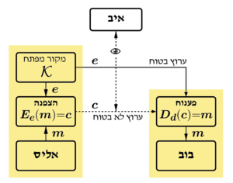
Basic Cryptographic tools
Secure Message Exchange Protocol:
symmetric-key based message exchange protocol:

Slide 41
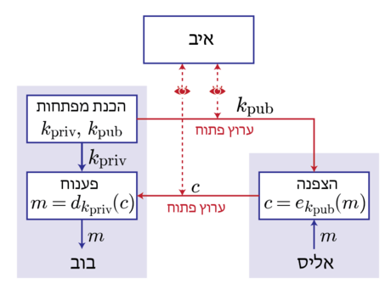
Basic Cryptographic tools
Secure Message Exchange Protocol:
Public (Asymmetric-key based message exchange protocol:

Slide 42
Basic Cryptographic tools
Secure Message Exchange Protocol:
For PPEM algorithms it’s recommended to use a public key based protocol that provides semantic security
All communications is assumed to use SMEP as means of communication.

Slide 43

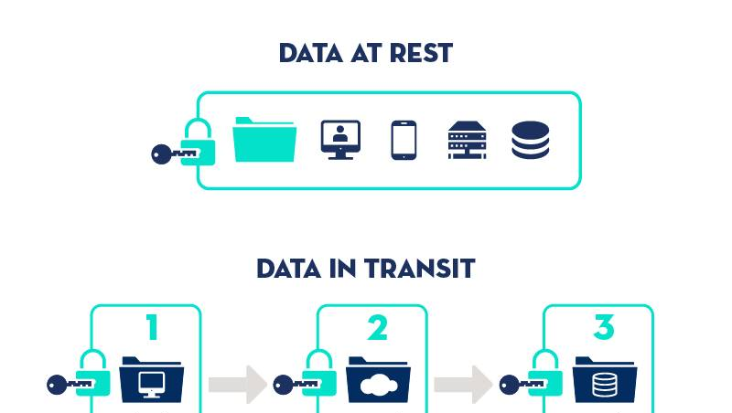
Basic Cryptographic tools
Encryption protocols :
Additive Homomorphic Encryption.
Trusted Execution Environment.

Slide 44
Basic Cryptographic tools
Secure Message Exchange Protocol:
symmetric-key or public-key(Asymmetric) based message exchange protocols that have the required security properties or the intended application will suffice for the PPEM algorithm.
For PPEM algorithms it’s recommended to use a public key based protocol that provides semantic security
All communications is assumed to use SMEP as means of communication.

Slide 45
Basic Cryptographic tools
Additive Homomorphic Encryption:
An additive homomorphic encryption scheme allows one to compute the sum of encrypted data without decrypting them.

Slide 46
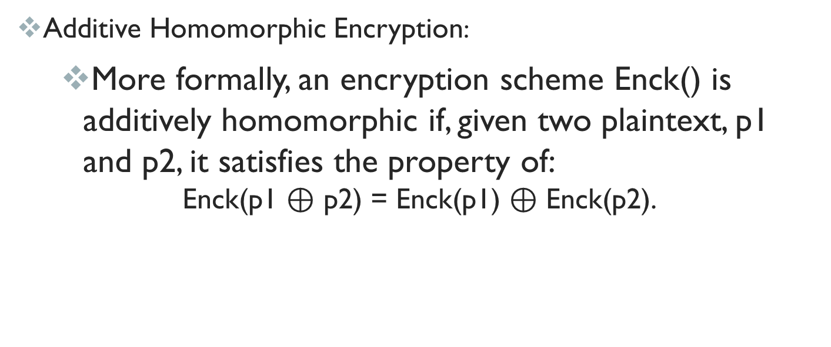
Basic Cryptographic tools
Additive Homomorphic Encryption:
More formally, an encryption scheme Enck() is additively homomorphic if, given two plaintext, p1 and p2, it satisfies the property of:
$$\text{Enck}\text{(}\text{p}\text{1 }\text{⊕ }\text{p}\text{2}\text{) = }\text{Enck}\text{(}\text{p}\text{1}\text{) }\text{⊕ }\text{Enck}\text{(}\text{p}\text{2}\text{).}$$

Slide 47
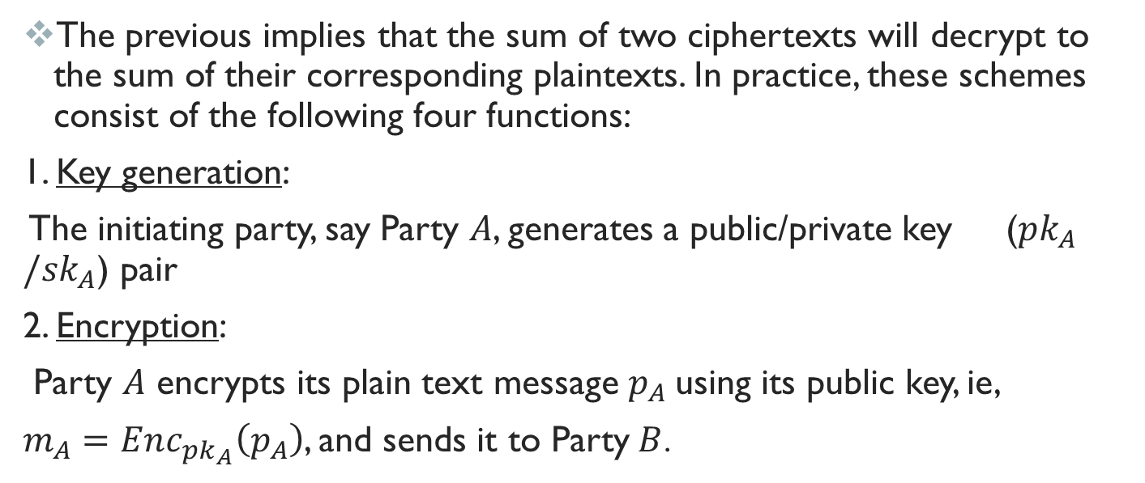
Basic Cryptographic tools
The previous implies that the sum of two ciphertexts will decrypt to the sum of their corresponding plaintexts. In practice, these schemes consist of the following four functions:
1. Key generation:
The initiating party, say Party $A$, generates a public/private key ($pk_{A}/sk_{A}$) pair
2. Encryption:
Party $A$ encrypts its plain text message $p_{A}$using its public key, ie,
$m_{A}=Enc_{pk_{A}}\left(p_{A}\right)$, and sends it to Party$B$.

Slide 48
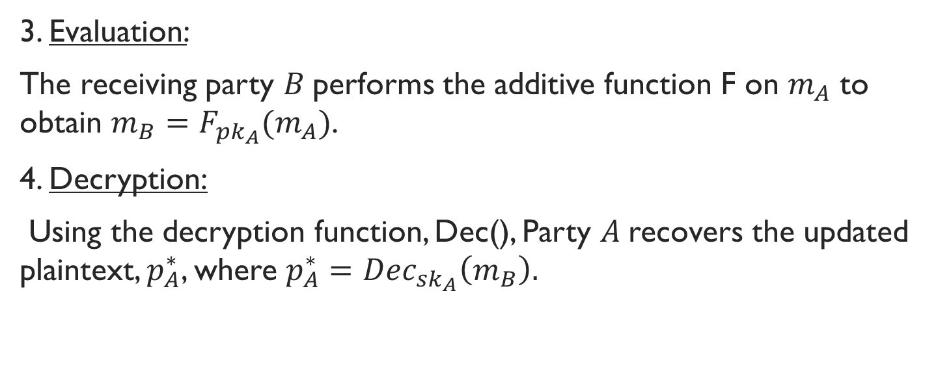
Basic Cryptographic tools
3. Evaluation:
The receiving party $B$performs the additive function F on $m_{A}$ to obtain $m_{B}=F_{pk_{A}}(m_{A})$.
4. Decryption:
Using the decryption function, Dec(), Party $A$recovers the updated plaintext, $p_{A}^{∗}$, where $p_{A}^{∗}=Dec_{sk_{A}}\left(m_{B}\right).$

Slide 49
Methods used on federated algorithms and collaborative learning modules
Federated learning , which consist of a central node that manages the other nodes in a network of nodes (Graph) ,this method can vary depending on the implementation and the connections between the nodes of the graph.
Peer to Peer :
Consists of a Full Graph meaning each node in the graph holds connection to all other nodes .
Summation :
Consists of a graph that isn’t fully connected , each node has a connection with at least two nodes .
Central Server approach:
Consists of a Central root node (server) with many variants of which some allow connections between nodes and some approaches don’t

Slide 50
Federated EM algorithm ON GMM
The general approach to the federated EM algorithm is broken down to the separation of the e-step or m-step into a local and collaborative step.
In the approach that we adopted as a base for our implementation the m-step is broken down to two stages :
Intermediate m-step (local m-step for each node)
Full m-step which merges all m-steps into one ( takes place in the main node)

Slide 51
Intermediate m-step
Why choose the m-step ?
Lest consider node i, with k GMM (Clusters) :
Firstly lets consider the e-step as a candidate for the split procedure .
Cons:
Privacy Risk :It contains too much information about the variables of each node
Costly : if we are talking about a big data base we would have to pay dearly as the responsibilities vector is as big as the input .
Local: can be done locally as it’s main objective is to determine the pdf function for the data i.e. determine if the data points match the GMM
Pros:
More precise : having all the responsibilities for the pdf function gives more accurate representation of the full data set .

Slide 52
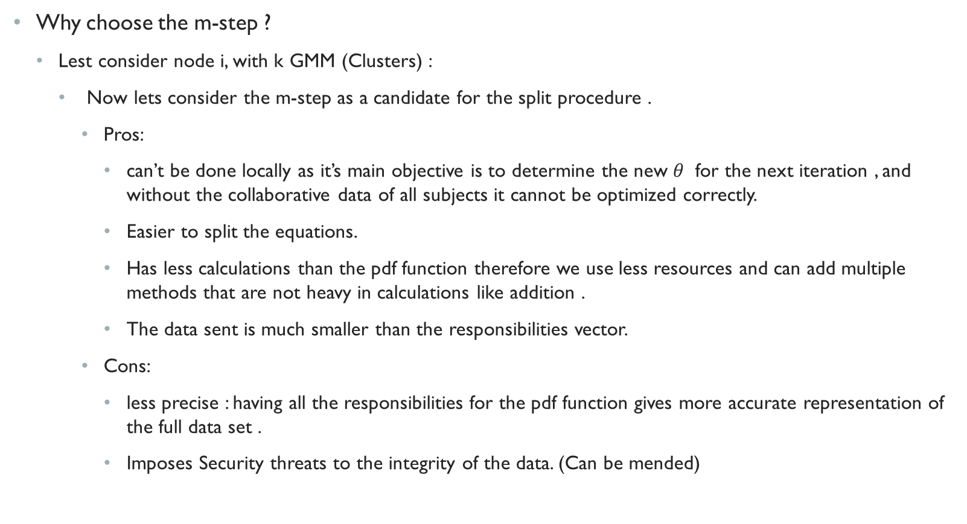
Intermediate m-step
Why choose the m-step ?
Lest consider node i, with k GMM (Clusters) :
Now lets consider the m-step as a candidate for the split procedure .
Pros:
can’t be done locally as it’s main objective is to determine the new $θ$ for the next iteration , and without the collaborative data of all subjects it cannot be optimized correctly.
Easier to split the equations.
Has less calculations than the pdf function therefore we use less resources and can add multiple methods that are not heavy in calculations like addition .
The data sent is much smaller than the responsibilities vector.
Cons:
less precise : having all the responsibilities for the pdf function gives more accurate representation of the full data set .
Imposes Security threats to the integrity of the data. (Can be mended)

Slide 53
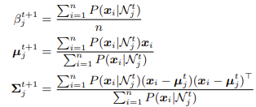
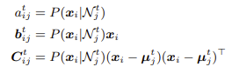
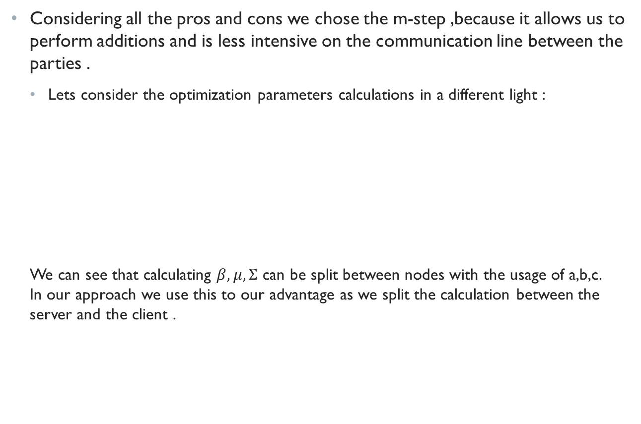
M-step
Considering all the pros and cons we chose the m-step ,because it allows us to perform additions and is less intensive on the communication line between the parties .
Lets consider the optimization parameters calculations in a different light :
We can see that calculating $β,μ,Σ$ can be split between nodes with the usage of a,b,c. In our approach we use this to our advantage as we split the calculation between the server and the client .

Slide 54
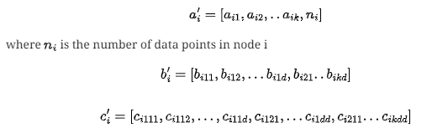
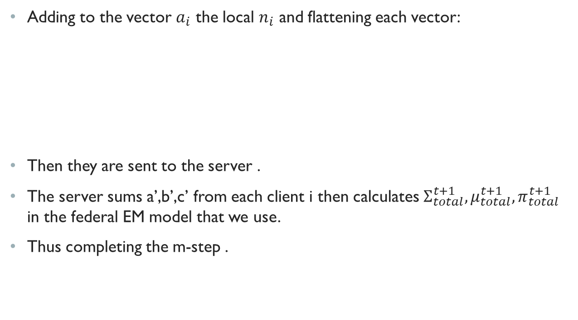
M-step
Adding to the vector $a_{i}$ the local $n_{i}$ and flattening each vector:
Then they are sent to the server .
The server sums a’,b’,c’ from each client i then calculates $Σ_{total}^{t+1},μ_{total}^{t+1},π_{total}^{t+1}$ in the federal EM model that we use.
Thus completing the m-step .

Slide 55
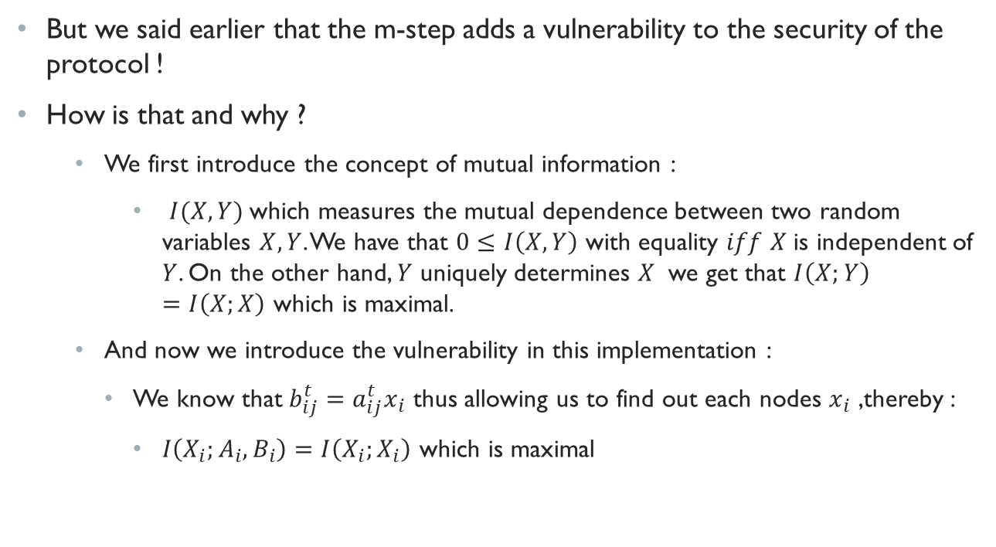
M-step
But we said earlier that the m-step adds a vulnerability to the security of the protocol !
How is that and why ?
We first introduce the concept of mutual information :
$I(X,Y)$which measures the mutual dependence between two random variables $X,Y$. We have that $0≤I\left(X,Y\right)$ with equality $iff$ $X$is independent of $Y$. On the other hand, $Y$ uniquely determines $X$ we get that $I\left(X;Y\right)=I\left(X;X\right)$ which is maximal.
And now we introduce the vulnerability in this implementation :
We know that$b_{ij}^{t}=a_{ij}^{t}x_{i}$ thus allowing us to find out each nodes $x_{i}$ ,thereby :
$I\left(X_{i};A_{i},B_{i}\right)=I\left(X_{i};X_{i}\right)$ which is maximal

Slide 56
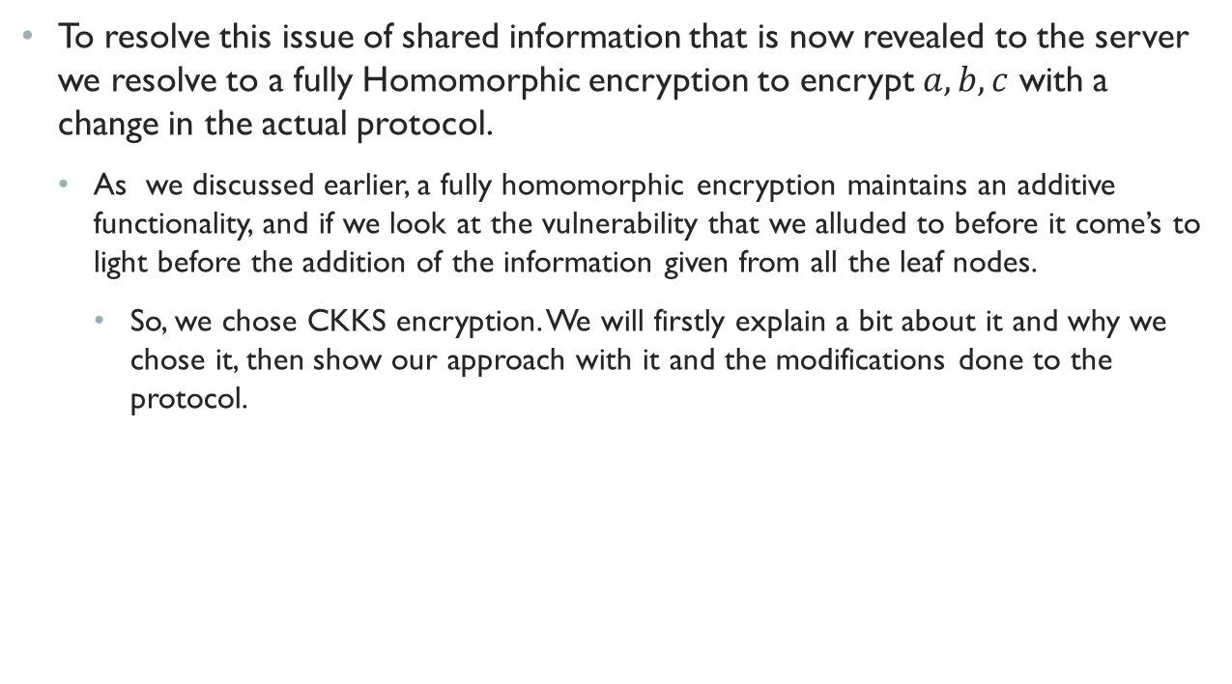
Our approach
To resolve this issue of shared information that is now revealed to the server we resolve to a fully Homomorphic encryption to encrypt $a,b,c$ with a change in the actual protocol.
As we discussed earlier, a fully homomorphic encryption maintains an additive functionality, and if we look at the vulnerability that we alluded to before it come’s to light before the addition of the information given from all the leaf nodes.
So, we chose CKKS encryption. We will firstly explain a bit about it and why we chose it, then show our approach with it and the modifications done to the protocol.

Slide 57
CKKS (Cheon-Kim-Kim-Song)
Overview:
Is a cryptographic technique that facilitates computations on encrypted data. With CKKS, real or complex number-based computations can be performed without decryption, preserving data privacy.

Slide 58
CKKS (Cheon-Kim-Kim-Song)
Data representation:
Encrypted data is represented as vectors of complex numbers, and operations like addition and multiplication are executed on the encrypted data. Noise is introduced during encryption, and while it accumulates and impacts accuracy, techniques like modulus switching and rescaling manage noise.

Slide 59
CKKS (Cheon-Kim-Kim-Song)
Applications:
CKKS finds applications in secure computations, enabling privacy-preserving machine learning and collaborative data analysis without revealing sensitive information.
Disadvantage:
CKKS entails computational overhead and necessitates parameter tuning for optimal performance.

Slide 60
CKKS (Cheon-Kim-Kim-Song)
How does CKKS work?
CKKS is based on a mathematical structure called a polynomial ring. This ring is formed using polynomials whose coefficients come from a number of ”slots”:
Each “slot” represents a value, typically a real or complex number.
The number of slots determines the capacity for computations in a single ciphertext.
It also involves generating a public key and a secret key pair. The public key is used to encrypt data, while the secret key is used to decrypt it.

Slide 61
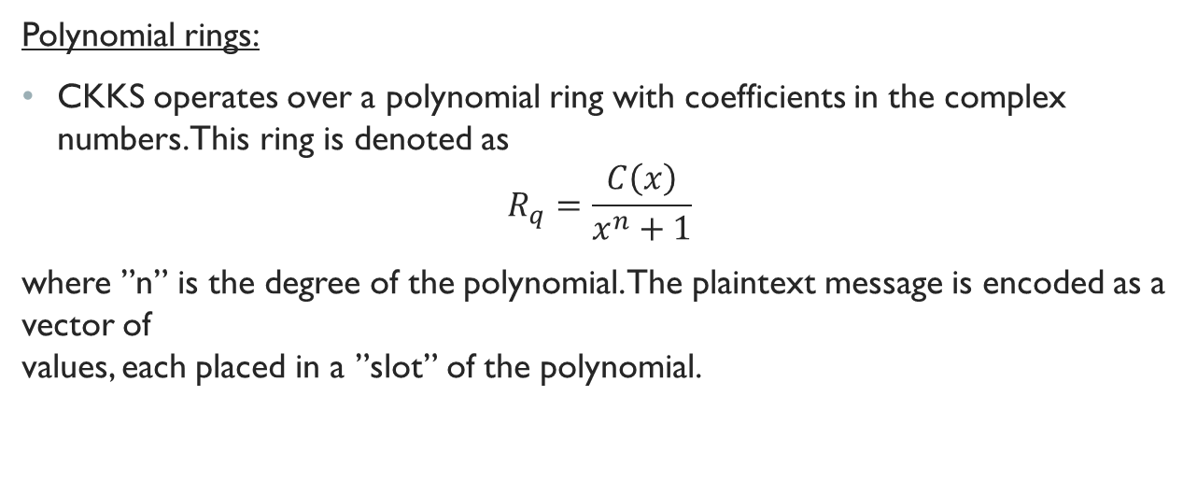
CKKS (Cheon-Kim-Kim-Song)
Polynomial rings:
CKKS operates over a polynomial ring with coefficients in the complex numbers. This ring is denoted as
$$R_{q}=\frac{C\left(x\right)}{x^{n}+1}$$
where ”n” is the degree of the polynomial. The plaintext message is encoded as a vector of values, each placed in a ”slot” of the polynomial.

Slide 62
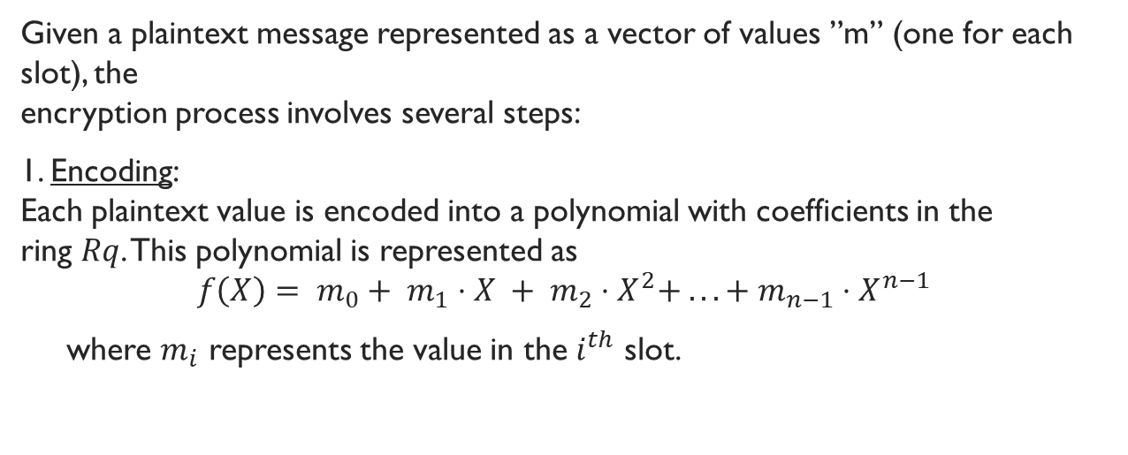
Encryption
Given a plaintext message represented as a vector of values ”m” (one for each slot), the encryption process involves several steps:
1. Encoding: Each plaintext value is encoded into a polynomial with coefficients in the ring $Rq$. This polynomial is represented as
$$f\left(X\right)= m_{0}+ m_{1}⋅X + m_{2}⋅X^{2}+ ... + m_{n−1}⋅X^{n−1}$$
where $m_{i}$ represents the value in the $i^{th}$ slot.

Slide 63
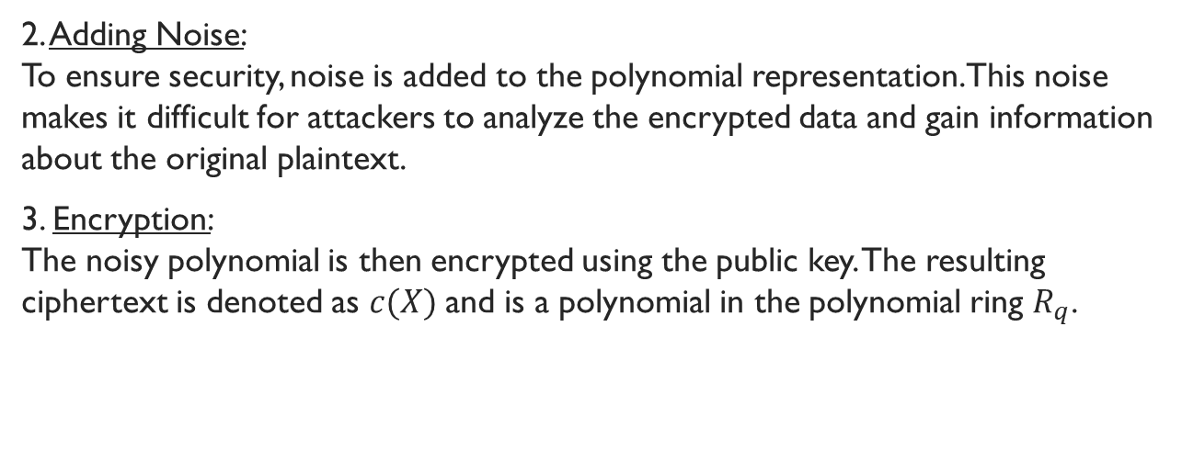
Encryption
2. Adding Noise: To ensure security, noise is added to the polynomial representation. This noise makes it difficult for attackers to analyze the encrypted data and gain information about the original plaintext.
3. Encryption: The noisy polynomial is then encrypted using the public key. The resulting ciphertext is denoted as $c(X)$and is a polynomial in the polynomial ring $R_{q}$.

Slide 64
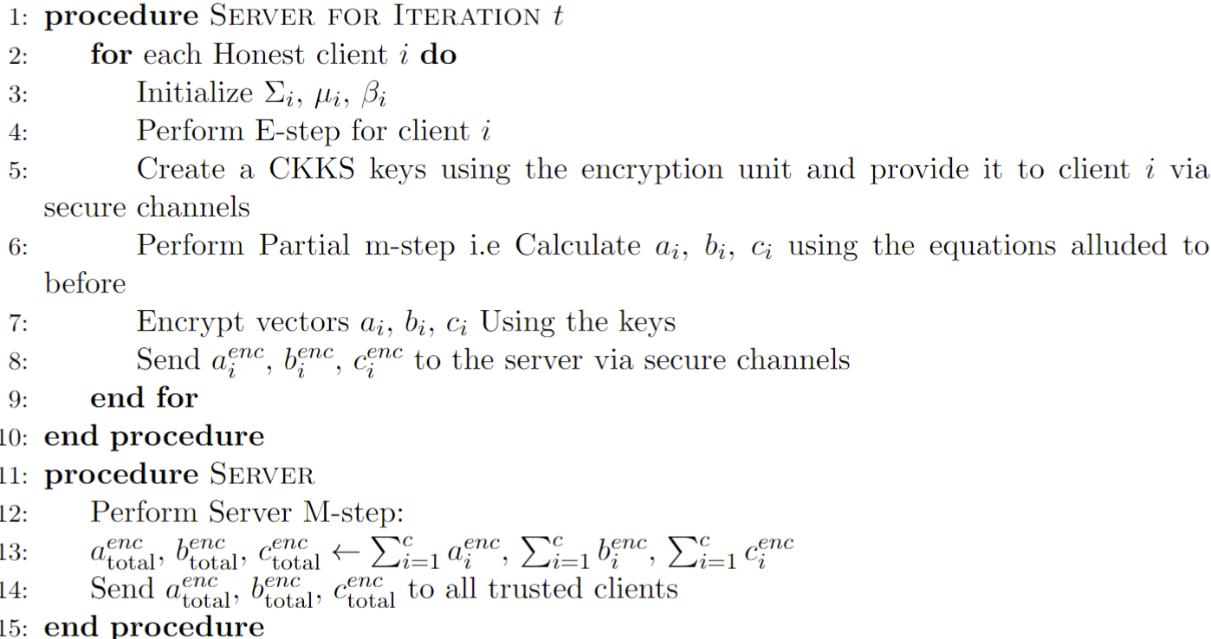
Our proposal

Slide 65
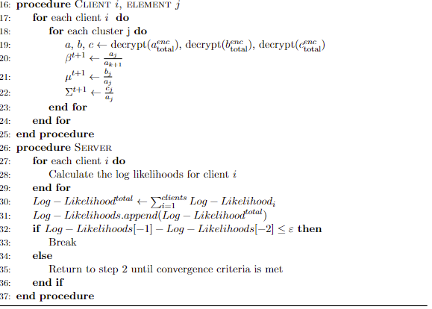
Our proposal

Slide 66
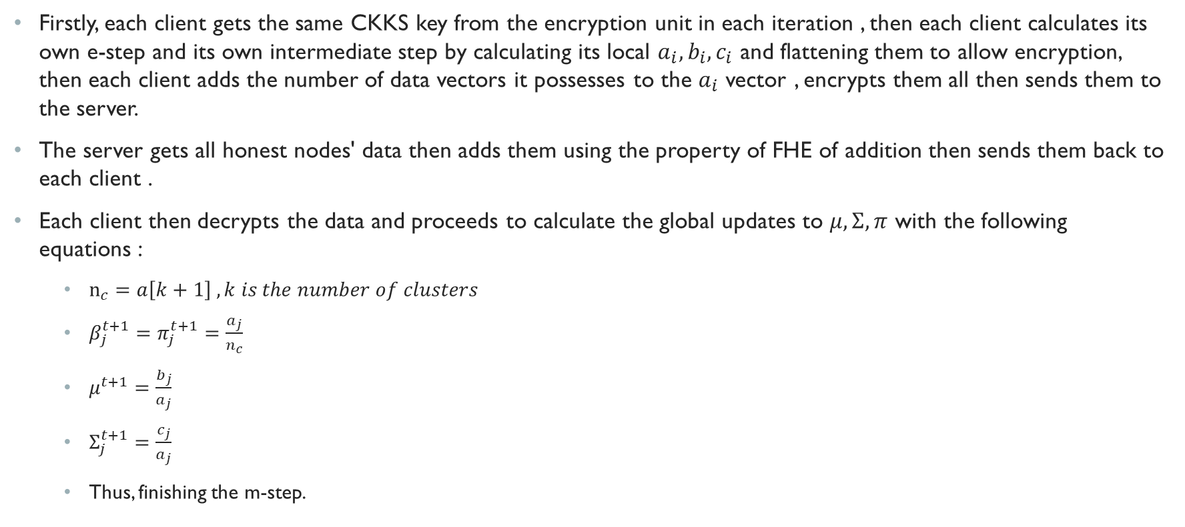
Brief explanation
Firstly, each client gets the same CKKS key from the encryption unit in each iteration , then each client calculates its own e-step and its own intermediate step by calculating its local $a_{i},b_{i},c_{i}$ and flattening them to allow encryption, then each client adds the number of data vectors it possesses to the $a_{i}$ vector , encrypts them all then sends them to the server.
The server gets all honest nodes' data then adds them using the property of FHE of addition then sends them back to each client .
Each client then decrypts the data and proceeds to calculate the global updates to $μ,Σ,π$ with the following equations :
$n_{c}=a\left[k+1\right] , k is the number of clusters$
$β_{j}^{t+1}=π_{j}^{t+1}=\frac{a_{j}}{n_{c}}$
$μ^{t+1}=\frac{b_{j}}{a_{j}}$
$Σ_{j}^{t+1}=\frac{c_{j}}{a_{j}}$
Thus, finishing the m-step.

Slide 67
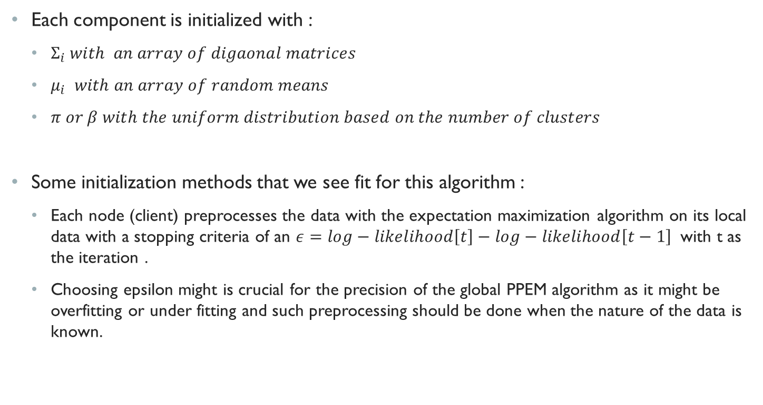
initialization
Each component is initialized with :
$Σ_{i} with an array of digaonal matrices$
$μ_{i}$ $with an array of random means$
$π or β with the uniform distribution based on the number of clusters$
Some initialization methods that we see fit for this algorithm :
Each node (client) preprocesses the data with the expectation maximization algorithm on its local data with a stopping criteria of an $ε=log−likelihood\left[t\right]−log−likelihood\left[t−1\right]$ with t as the iteration .
Choosing epsilon might is crucial for the precision of the global PPEM algorithm as it might be overfitting or under fitting and such preprocessing should be done when the nature of the data is known.

Slide 68
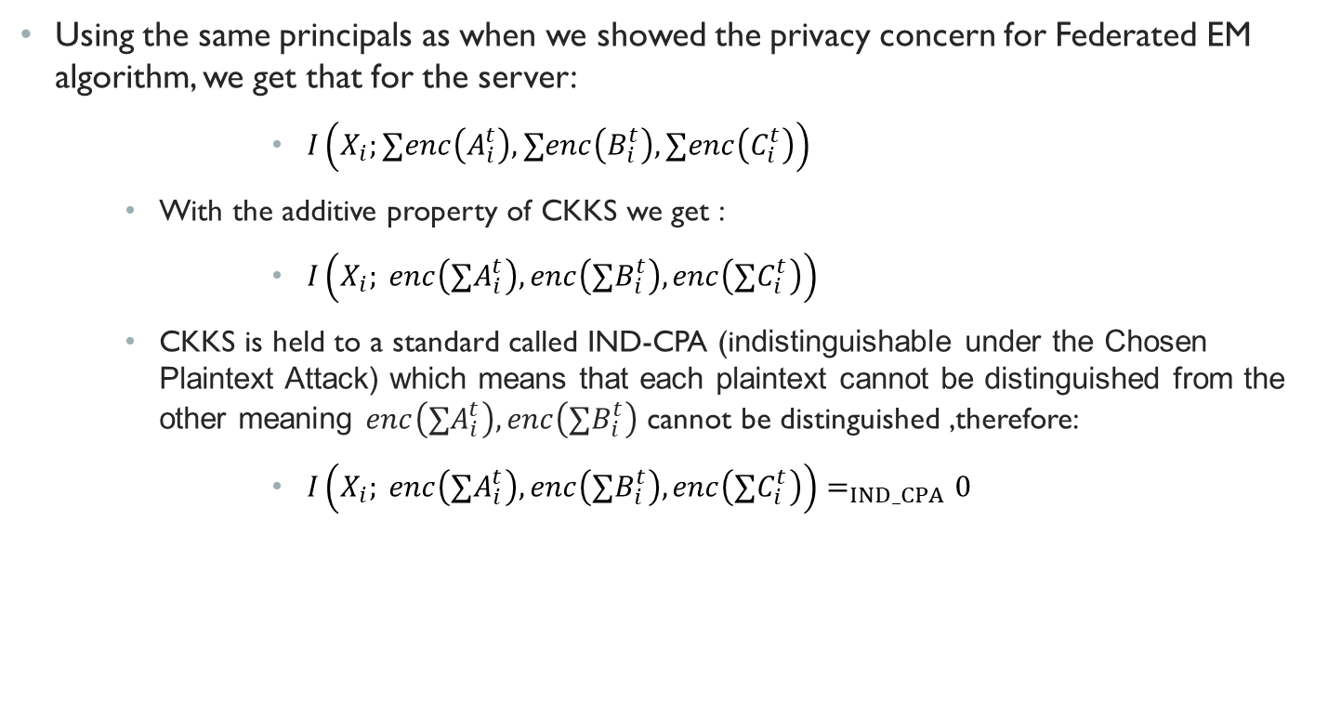
Privacy
Using the same principals as when we showed the privacy concern for Federated EM algorithm, we get that for the server:
$I\left(X_{i};∑enc\left(A_{i}^{t}\right),∑enc\left(B_{i}^{t}\right),∑enc\left(C_{i}^{t}\right)\right)$
With the additive property of CKKS we get :
$I\left(X_{i}; enc\left({∑A}_{i}^{t}\right), enc\left(∑B_{i}^{t}\right),enc\left(∑C_{i}^{t}\right)\right)$
CKKS is held to a standard called IND-CPA (indistinguishable under the Chosen Plaintext Attack) which means that each plaintext cannot be distinguished from the other meaning $enc\left({∑A}_{i}^{t}\right), enc\left(∑B_{i}^{t}\right)$ cannot be distinguished ,therefore:
$I\left(X_{i}; enc\left({∑A}_{i}^{t}\right), enc\left(∑B_{i}^{t}\right),enc\left(∑C_{i}^{t}\right)\right)=_{IND_CPA}0$

Slide 69
Privacy
The encryption keys are generated in each iteration , Why does that matter?
To address a passive (such as eavesdropping) adversary on the server:
Giving the same key over a large enough number of iterations can allow the attacker to find patterns in the noise of the public key which then can help him figure out the private key .
If the private key is revealed the full data set of each client would be compromised

Slide 70
Correctness of the output
We used Parkinson's dataset from the UCI Repository to validate our results against the Federated EM.
A data set that contains voice measurements from 31 people of which 23 have the Parkinson's disease and 9 are healthy that consists of 195 samples each person with 6 different samples with 22 features each.
This data set was chosen for two reasons :
Firstly, it contains highly sensitive data which are biomedical voice measurements of individuals.
Secondly, we wanted to validate the algorithm on a real-world use case and see how it would perform.

Slide 71
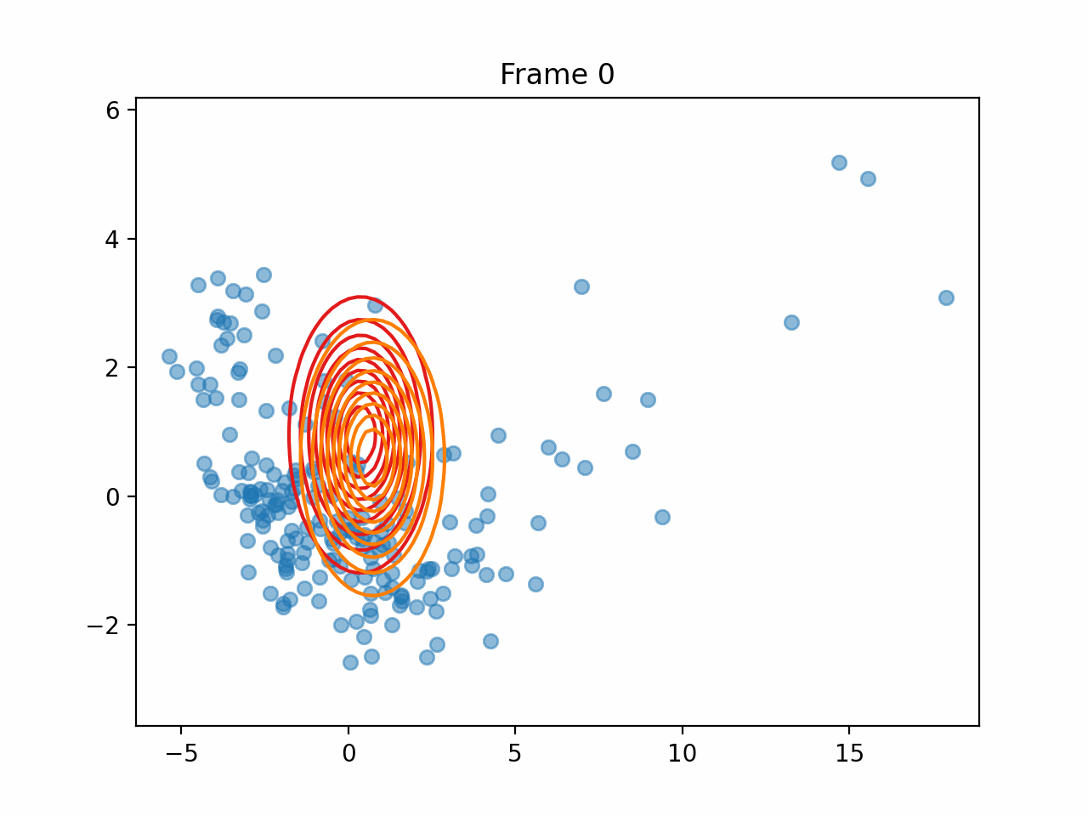
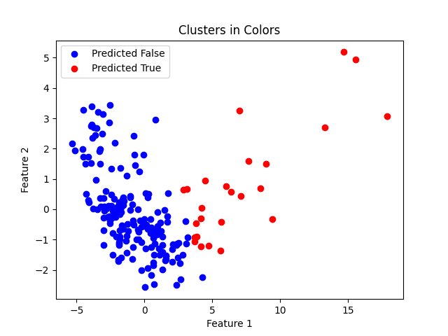
Correctness of the output
We reduced the dimensions of the dataset using PCA (principal component analysis) and used the two components that we got from PCA for GMM fitting on both Federated EM and our approach.

Slide 72
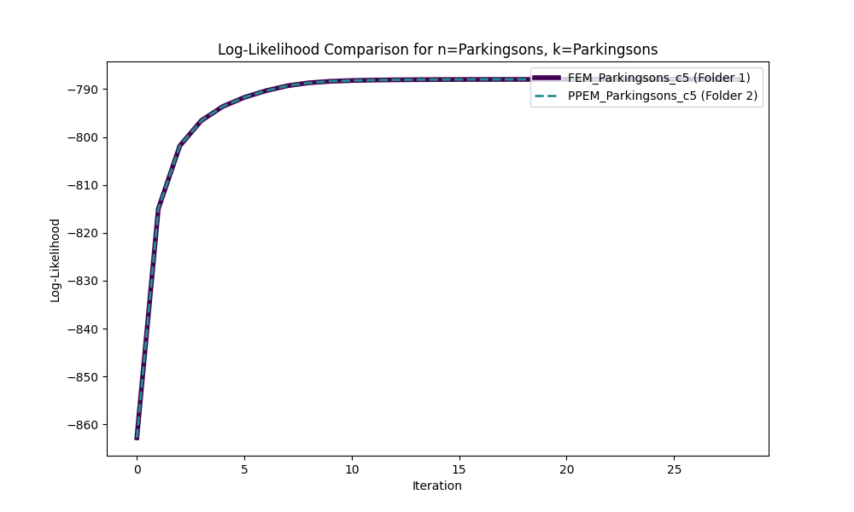
FEM VS PPEM ON Parkinson’s Data

Slide 73
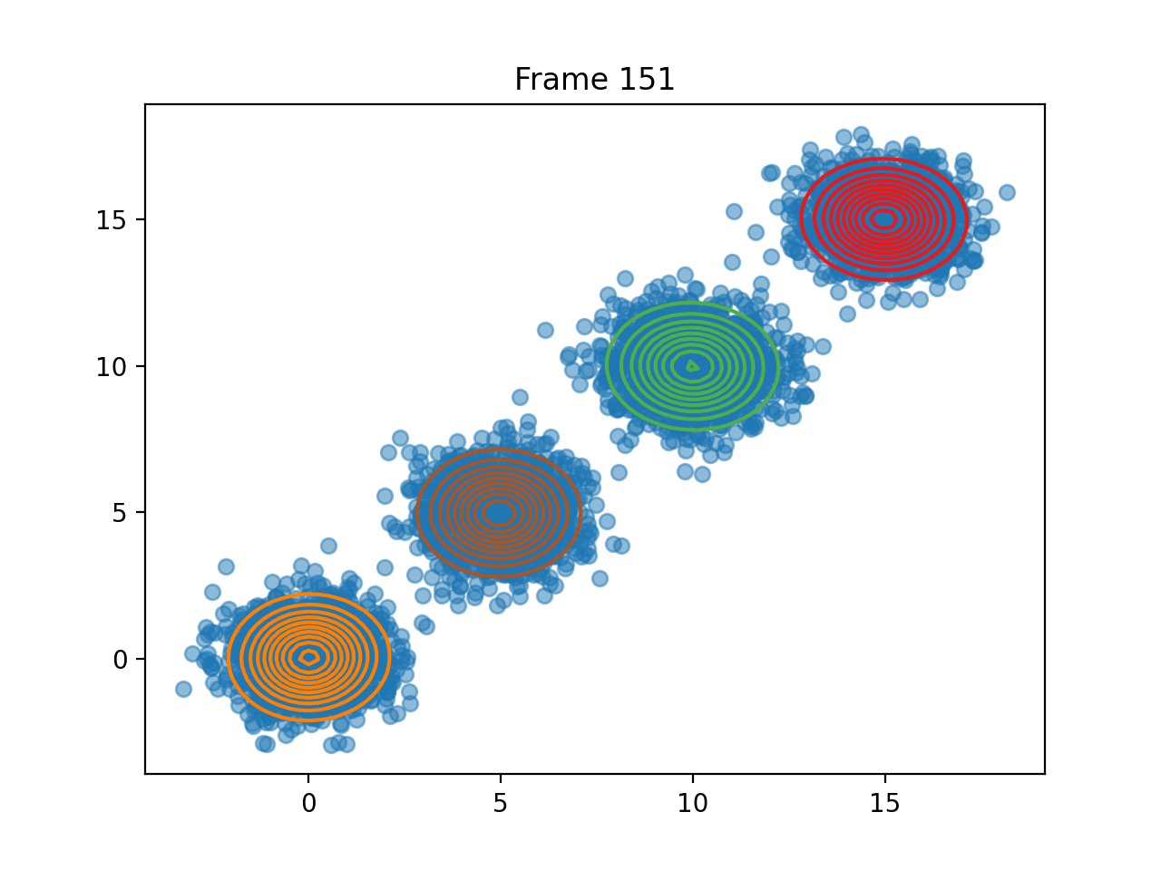
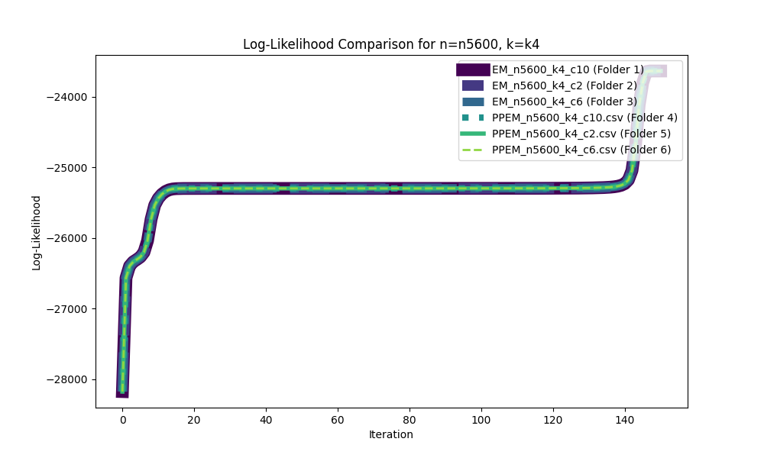
Correctness of the output
We also conducted a variety of tests on randomized data with different number of datapoints , nodes (clients) and clusters , the final results are all in our GitHub repository and attached in the paper as a chart :

Slide 74
Feature enhancements
Implementing a threshold encryption method:
check the validity of the client and the validity of the server:
Elliptic Curve Digital Signature Algorithm
Edwards-curve Digital Signature Algorithm
CKKS implementation:
Our implementation of ckks can be altered to accommodate the malicious adversary by using the Galois keys's rotation property , as we can rotate the data for each client differently.
replacing the vectors a,b,c into a new vector that mixes the a,b,c vectors into one vector and then using a higher modulus degree to accommodate for the vectors size
There is a new implementation of CKKS that allows addition between two different encrypted values that have a different private key called multi-key CKKS variant.

Slide 75
Conclusions
Thank you for taking interest in our paper and we would like to give a special thanks to our esteemed lecturer Prof. Adi Akvia for her dedication to her students and her passion for Secure cloud computing .
And a broad thanks to the full community of researchers that helped us get access to enough knowledge that lightens our minds and the minds of all aspiring Computer Science enthusiasts.

Slide 76
references
[1] Abdulatif Alabdulatif, Ibrahim Khalil, Albert Y Zomaya, Zahir Tari, and Xun Yi. Fully homomorphic based privacy-preserving distributed expectation maximization on cloud. IEEE Transactions on Parallel and Distributed Systems, 31(11):2668–2681, 2020.
[2] Ayoub Benaissa, Bilal Retiat, Bogdan Cebere, and Alaa Eddine Belfedhal. Tenseal: A library for encrypted tensor operations using homomorphic encryption. arXiv preprint arXiv:2104.03152, 2021.
[3] Kanishka Bhaduri and Ashok N Srivastava. A local scalable distributed expectation maximization algorithm for large peer-to-peer networks. In 2009 Ninth IEEE Interna- tional Conference on Data Mining, pages 31–40. IEEE, 2009. 21
[4] Ravi Charan. Expectation Maximization Explained — to- wardsdatascience.com. https://towardsdatascience.com/ expectation-maximization-explained-c82f5ed438e5. [Accessed 10-09-2023].
[5] Hao Chen, Wei Dai, Miran Kim, and Yongsoo Song. Efficient multi-key homomor- phic encryption with packed ciphertexts with application to oblivious neural network inference. In Proceedings of the 2019 ACM SIGSAC Conference on Computer and Communications Security, pages 395–412, 2019.
[6] Jung Hee Cheon, Andrey Kim, Miran Kim, and Yongsoo Song. Homomorphic en- cryption for arithmetic of approximate numbers. Cryptology ePrint Archive, Paper 2016/421, 2016. https://eprint.iacr.org/2016/421.

Slide 77
references
[7] Dheeru Dua, Casey Graff, et al. Uci machine learning repository. 2017.
[8] Sharon X Lee, Kaleb L Leemaqz, and Geoffrey J McLachlan. Ppem: Privacy-preserving em learning for mixture models. Concurrency and Computation: Practice and Experi- ence, 31(24):e5208, 2019.
[9] Baiyu Li, Daniele Micciancio, Mark Schultz, and Jessica Sorrell. Securing approximate homomorphic encryption using differential privacy. In Annual International Cryptology Conference, pages 560–589. Springer, 2022.
[10] Qiongxiu Li, Jaron Skovsted Gundersen, Katrine Tjell, Rafal Wisniewski, and Mads Græsbøll Christensen. Privacy-preserving distributed expectation maximization for gaussian mixture model using subspace perturbation. In ICASSP 2022-2022 IEEE International Conference on Acoustics, Speech and Signal Processing (ICASSP), pages 4263–4267. IEEE, 2022.
[11] Xiaodong Lin, Chris Clifton, and Michael Zhu. Privacy-preserving clustering with distributed em mixture modeling. Knowledge and information systems, 8:68–81, 2005.
[12] Max Little, Patrick Mcsharry, Stephen Roberts, Declan Costello, and Irene Moroz. Ex- ploiting nonlinear recurrence and fractal scaling properties for voice disorder detection. Nature Precedings, pages 1–1, 2007.

Slide 78
references
[13] Mijung Park, James Foulds, Kamalika Choudhary, and Max Welling. Dp-em: Differen- tially private expectation maximization. In Artificial Intelligence and Statistics, pages 896–904. PMLR, 2017.
[14] Amir Hossein Poorjam, Yordan P Raykov, Reham Badawy, Jesper Rindom Jensen, Mads Græsbøll Christensen, and Max A Little. Quality control of voice recordings in remote parkinson’s disease monitoring using the infinite hidden markov model. In ICASSP 2019-2019 IEEE International Conference on Acoustics, Speech and Signal Processing (ICASSP), pages 805–809. IEEE, 2019.
[15] Bin Yang, Issei Sato, and Hiroshi Nakagawa. Privacy-preserving em algorithm for clustering on social network. In Advances in Knowledge Discovery and Data Mining: 16th Pacific-Asia Conference, PAKDD 2012, Kuala Lumpur, Malaysia, May 29-June 1, 2012, Proceedings, Part I 16, pages 542–553. Springer, 2012. 22
[16] Zhe Zhang and Linjun Zhang. High-dimensional differentially-private em algorithm: Methods and near-optimal statistical guarantees. arXiv preprint arXiv:2104.00245, 2021.
[17] Appendix A in the article ,explaining the GMM variant of Expectation Maximization protocol
[18] Appendix B in the article, explaining a Privacy Preserving Expectation Maximization variant over Generalized Linear Mixed Model (GLMM)

